Slide 1
A Geovisual Framework with Open Data for Novice Users
Michael Crowder
Lauren Darr
Gerardo Garza
Brent Allan

Slide 2
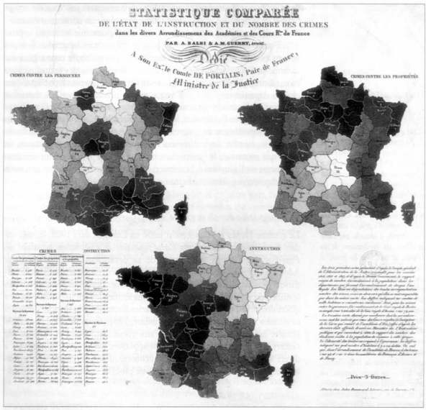
Crime Mapping
1830s Guerry maps crime rates and education in France
Birth of criminology and sociology
1990s crime mapping goes digital
Police adoption of digital maps remains complicated

Slide 3
Crime Mapping
Multi-purpose:
Shaping policy/strategy
Hot spot mapping
Crisis intervention
Public transparency and engagement
Police User
Citizen User

Slide 4

Transparency
"Law enforcement agencies should also establish
a culture of transparency and accountability to
build public trust and legitimacy. "

Slide 5
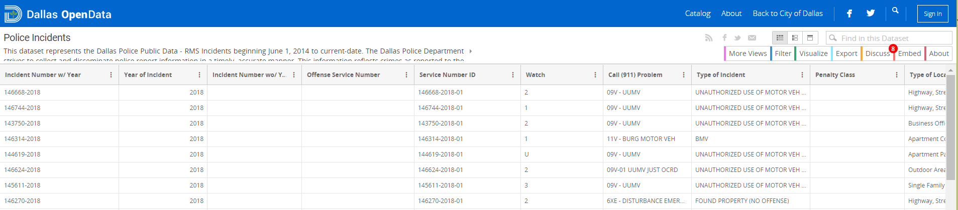
Open Data
Is open data really open at all?
Yes and No
Does the public know what or how to use:
Comma-separated values (.csv)
JavaScript Object Notation (JSON)
Application Programming Interface (API)
Does a giant data table engage the public?

Slide 6
Motivation
Two part:
New national standard for crime reporting called NIBRS (National Incident-Based Reporting System)
No current standards for geographical visualization of NIBRS data for the public

Slide 7
Motivation
National Incident-Based Reporting System
New crime reporting standard starting in 2021
Allows up to 10 offenses per incident
Higher level detail on less serious crimes
Goals:
Enhanced quantity, quality, timeliness of crime data
Improved compiling, analyzing, auditing, and publishing

Slide 8
Motivation
National Incident-Based Reporting System
New crime reporting standard starting in 2021
Allows up to 10 offenses per incident
Higher level detail on less serious crimes
Goals:
Enhanced quantity, quality, timeliness of crime data
Improved compiling, analyzing, auditing, publishing

Slide 9
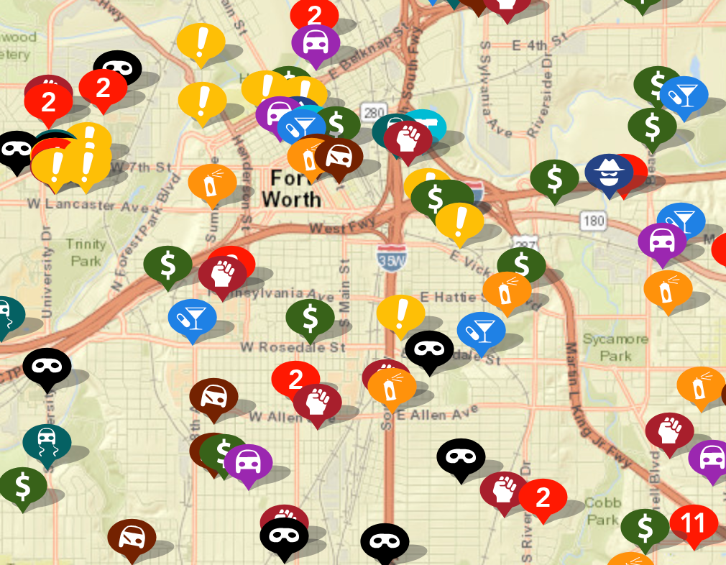
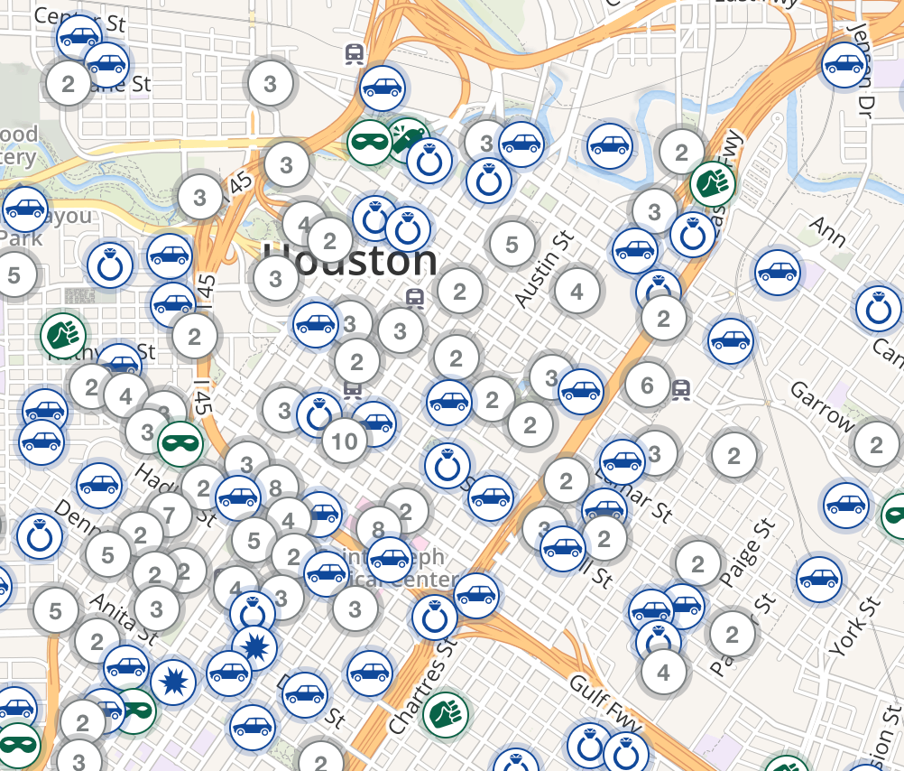
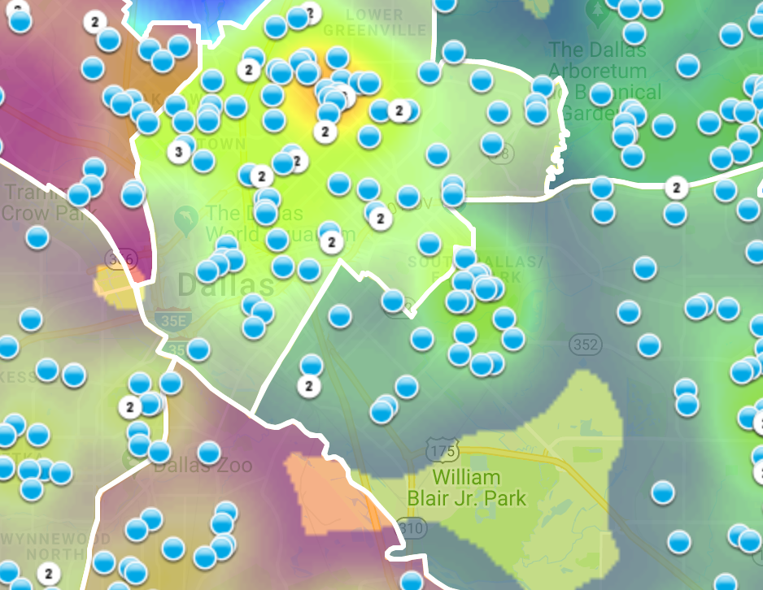
Motivation
No LEA standards:
Crime maps published by assortment of groups
Data source can be unclear
Variety of design features and quality
https://www.crimemapping.com/
https://www.crimereports.com
https:www.cityofirving.org

Slide 10
Data Source
Data source
City of Dallas Open Data Portal
Police Incident Data
386K Rows
103 Columns
2015 - 2018
Example variable- burglaries
Ability to segment
Not an overwhelming number like breaking into cars

Slide 11
Data Source
Data source
City of Dallas Open Data Portal
Police Incident Data
386K Rows
103 Columns
2015 - 2018
Our mapping focuses on burglaries
Ability to segment
Not an overwhelming number like breaking into cars

Slide 12
Map Making
Mapping with open-source products
R
Leaflet – Open-source JavaScript library

Slide 13
Map Making
Mapping handled through open-source products
R
Leaflet – Open-source JavaScript library

Slide 14
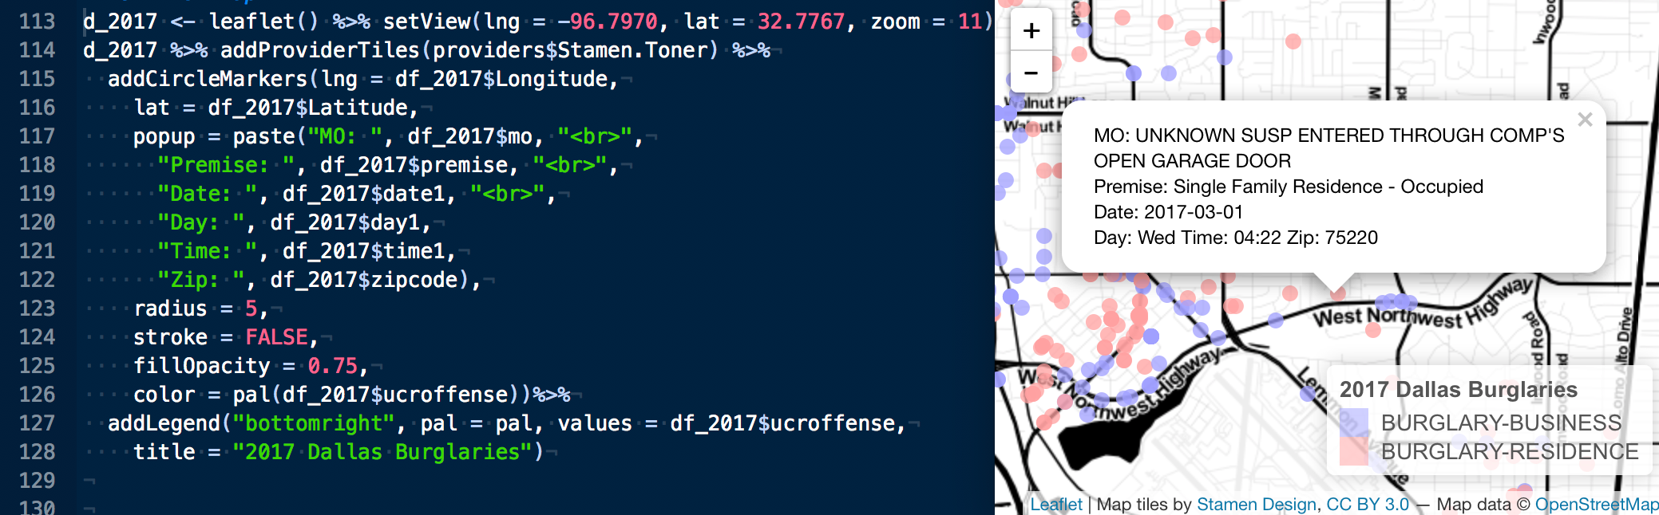
Map Making
Mapping handled through open-source products
R
Leaflet – Open-source JavaScript library

Slide 15
Intro to framework
Law Enforcement Agencies
On Average employ 68 people
31% are civilians
That’s around 20 people to run

Slide 16
Intro to framework
Law Enforcement Agencies
On Average employ 68 people
31% are civilians
That’s around 20 people to run
911 Operators
Dispatchers
Forensics
Mechanics
HR
Finance
https://www.bjs.gov/content/pub/pdf/lpd13ppp.pdf

Slide 17
Intro to framework
Law Enforcement Agencies
On Average employ 68 people
31% are civilians
That’s around 20 people to run
911 Operators
Dispatchers
Forensics
Mechanics
HR
Finance
https://www.bjs.gov/content/pub/pdf/lpd13ppp.pdf

Slide 18
Geovisual Framework
Interactive
Time Bound
Contain variable(s)
Data Colors
Base Maps
Map Types

Slide 19
Geovisual Framework
Interactive
Time Bound
Contain variable(s)
Data Colors
Base Maps
Map Types

Slide 20
Interactivity
Cartographic Interaction
The use of a digital map by a user facilitated by a computer.

Slide 21
Interactivity
Interaction with maps allows users to explore scenes dynamically
Ability to vary scenes with changing scale and location spatially.
Enhanced user engagement leads to learning and understanding.

Slide 22
Interactivity
Interaction with maps allows users to explore scenes dynamically
Ability to vary scenes with changing scale and location spatially.
Enhanced user engagement leads to learning and understanding.
Use goes beyond crime mapping
Medical, engineering, biology, etc.

Slide 23
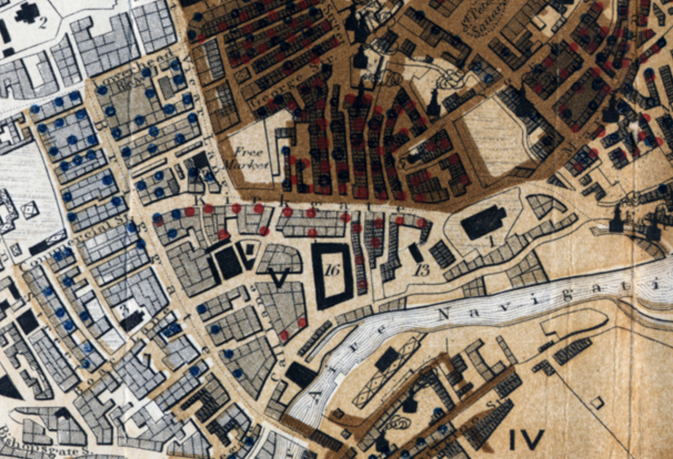
Color
The goal of color in a map is to give a clear visual indication of what is happening on the earth[x].
“Sanitary Map of the Town of Leeds” 1842
Blue dots are cholera
Orange dots are other contagious diseases

Slide 24
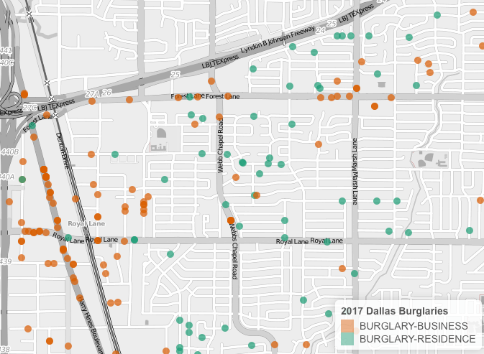
Color
Graphically showing the difference between entities by using color

Slide 25
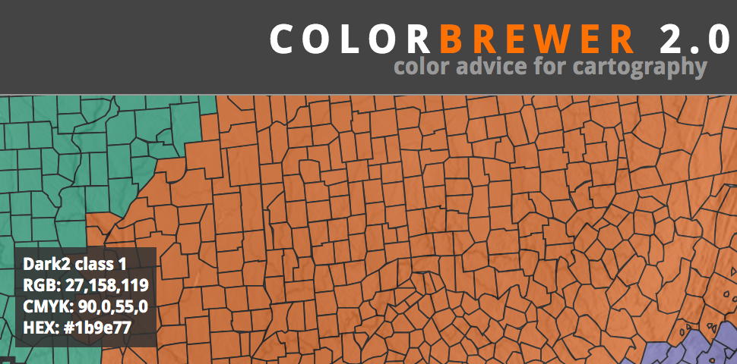
Color
Graphically showing the difference between entities by using color
Color Brewer[x]
Online tool for selecting color schemes for maps.

Slide 26
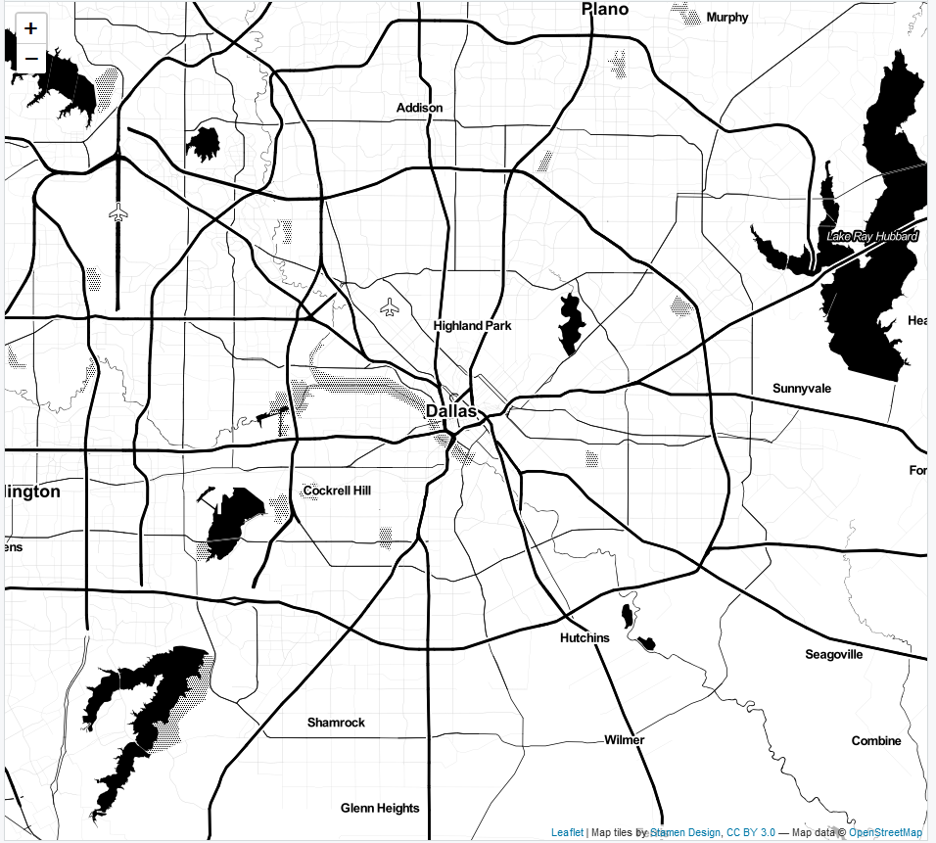
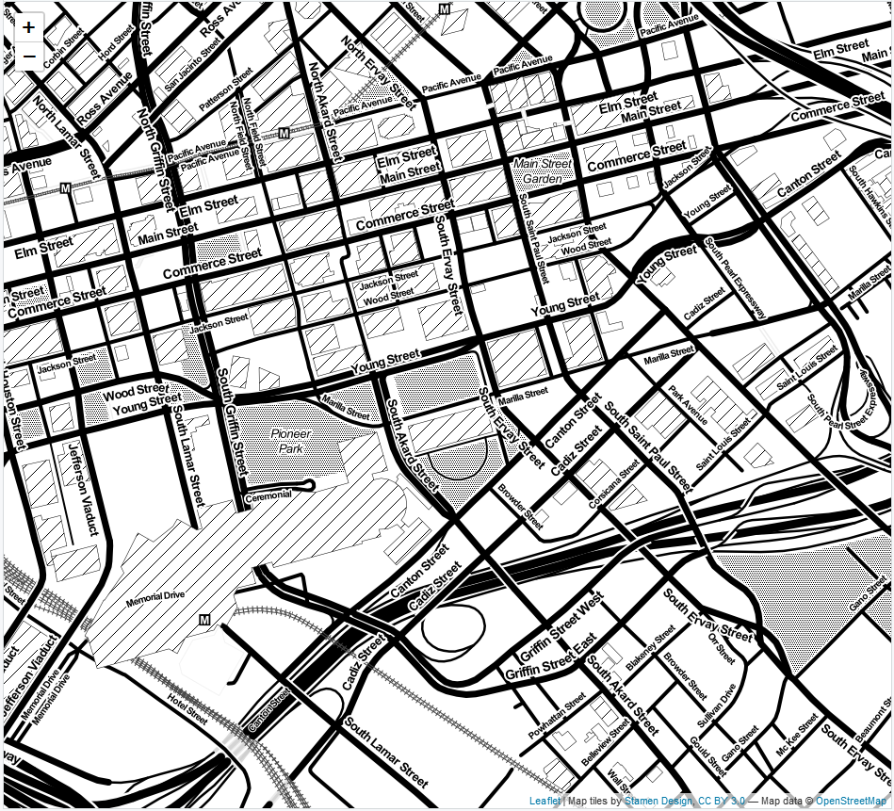
Basemaps
Zoom: ‘11’
Zoom: ‘16’
Leaflet, 3rd party, or custom map tiles
Landscape of chosen design and detail
Layering capability
2-lines of code

Slide 27
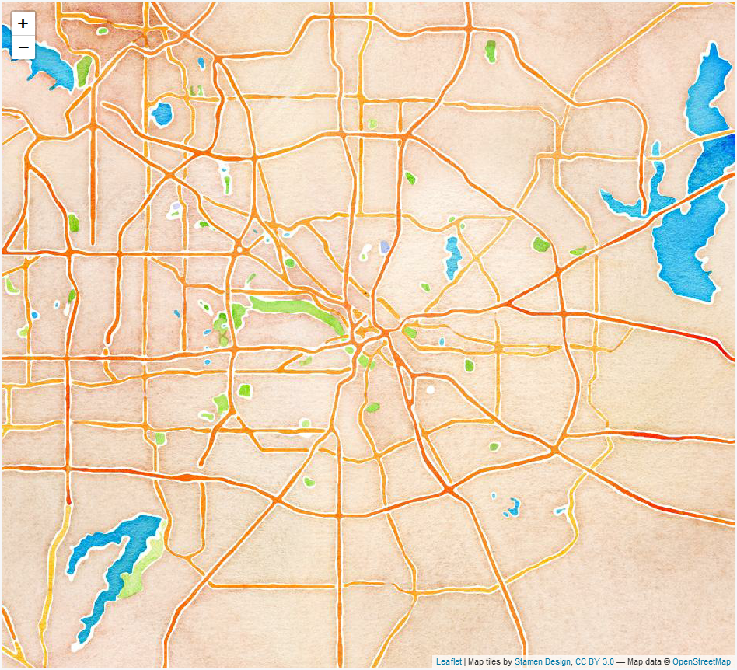
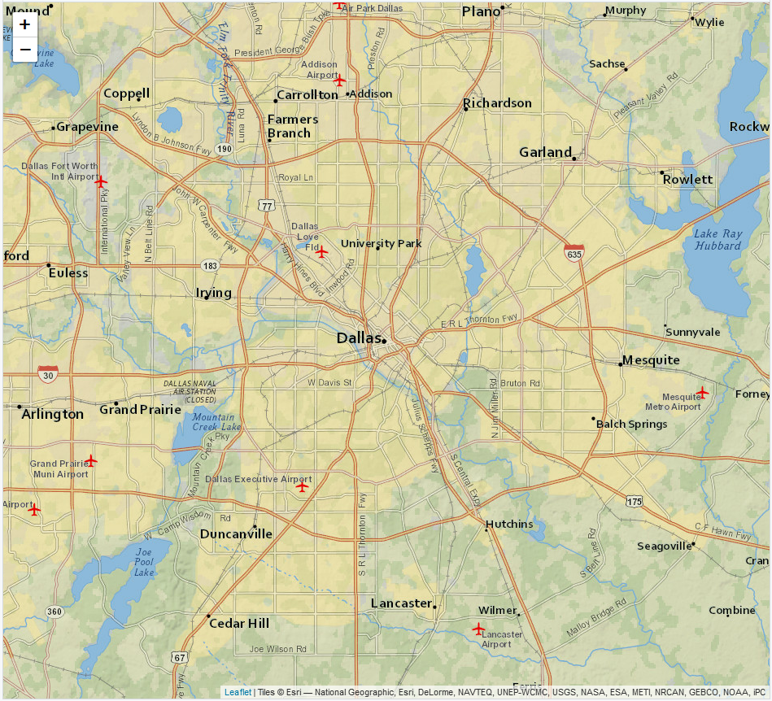
Basemaps
Artistry v. Clarity
Watercolor
Zoom: ‘11’
NatGeo
Zoom: ‘11’

Slide 28
Map Types
Dot Map
Discrete, multiple variables
View of landscape
Dot size can be misleading
Opacity for density

Slide 29
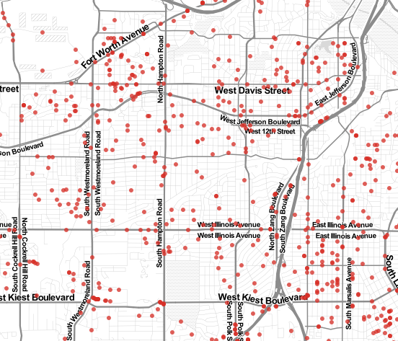
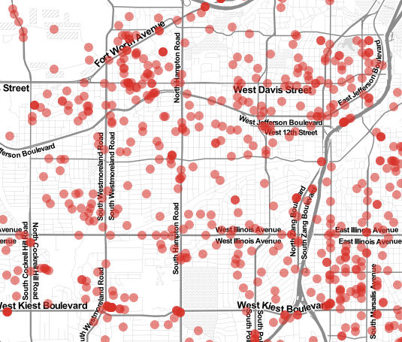
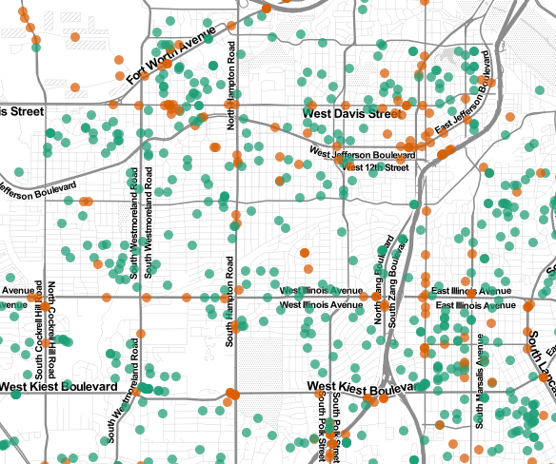
Map Types
Dot Maps at the same scale different dots
Small Dots
Large Transparent Dots
Multiple Variables

Slide 30
Map Types
Cluster Map
Solution to densely populated dot map
Mouse over feature shows captured area
‘Spiderfy’ shows individual markers on close up
Computationally more efficient than dot

Slide 31
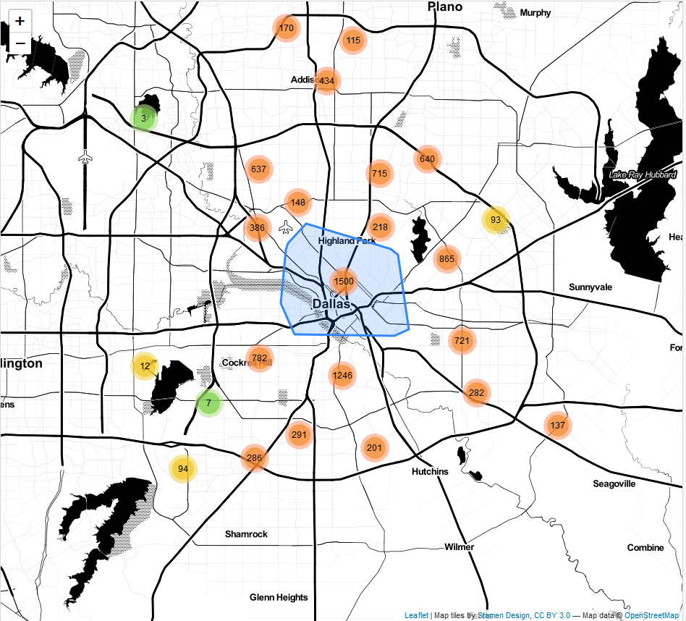
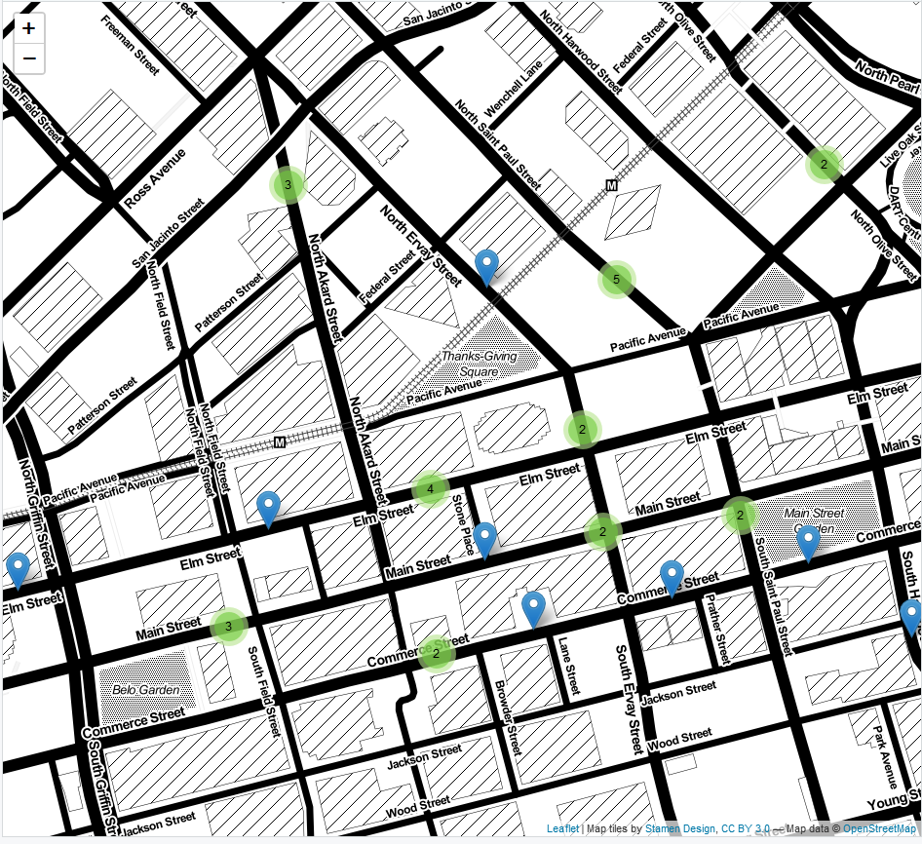
Map Types
Cluster Map
Mouse Hover
Zoom: ‘11’
2 Cluster Zoom
‘Spiderfy’ markers

Slide 32
Map Types
Heat Map
Density, higher level view
Heat v. Hot Spot important distinction
Single variables

Slide 33
Map Types
Heat Map
*Map examples

Slide 34
Variable Selection
Tradeoff between abstraction and reality
Number of incident types
SRS- 8 offense categories
NIBRS- 46 Group A, 11 Group B categories
Community input: what do citizens want to see?

Slide 35
Variable Selection

Slide 36
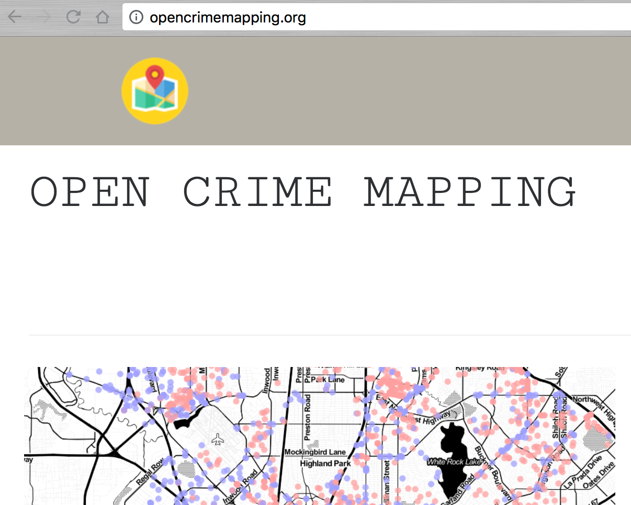
Deployment & Conclusion
Website!!!!!!!!!

Slide 37
Deployment & Conclusion

Slide 38
Deployment & Conclusion

Slide 39
Deployment & Conclusion
Our framework sets out to guide smaller LEA’s in communicating to the citizen user with geovisualization
Time-bound
Limited variables
Well thought out colors
Right map for the right incident
Clean easy to read base maps
Interactive

